Slide 1





Introduction to MAPPING@Brown and Breakout Sessions
Mark Lurie, PhD
MAPPS PI; Assoc. Professor of Epidemiology;
Interim Director, International Health Institute
Peyton Luiz
MAPPS Project Manager
Thomas Trikalinos, MD, PhD
Professor of Health Services, Policy and Practice & Biostatistics; Director, CESH
Jason Gantenberg, PhD
Asst. Professor of Epidemiology Research Scientist, Dept. of Health Services, Policy and Practice
Guixing Wei, PhD
Senior Research Scientist, S4 and PSTC
Kimani Toussaint, PhD
Professor of Engineering; Senior Assoc.
Dean, School of Engineering

Slide 2

MAPPING@Brown
Overarching, proof-of-concept activity
5-year goal:
To map the entire social network at Brown (!)
18-month goals:
Device development
Deep community engagement
Pilot in Brown School of Public Health in AY 2022/23

Slide 3
MAPPING@Brown: Main Goals
Measure the social network at Brown University
Use the social network data to populate flexible and realistic mathematical models of disease transmission
Intervention assessment: Explore transmission dynamics under different scenarios of social mixing and mobility
Simulation exercise
Introduce a virtual pathogen with specific epidemiological characteristics into the network and observe spread through the network
Identify point of intervention/changes in social mixing that would be effective at elimination or containment of the virtual pathogen

Slide 4
MAPPING@Brown: How
Long and deep community engagement
Identifying potential barriers to participation
Addressing concerns about confidentiality and data use
Develop technology
Think deeply about ethical issues
Exploring differential privacy and ways of protecting user data

Slide 5
MAPPING@Brown: Some questions we are pondering
Can we find a reasonable workable balance where data is available for scientific purposes but carefully protected?
What to do with personal identifying information?
What demographic data do we need to collect and how do we balance that?
How do we talk/think/discuss/address the variety of concerns users will likely have?

Slide 6
MAPPING@Brown: Some questions we are pondering
Can users see their own data?
Should the app only track in a limited geographical boundary?
Should users be able to turn on/off certain features?
Do we want to incentivize the app?
Will the app drain battery life?
How frequently should we take measurements?
Do we want to use passive data collected by Brown (wifi logins, card swipes, etc) and if so, how?

Slide 7



Timeline: MAPPING@Brown
Phase 1
Small pilot within the SPH using Bluetooth to measure social interaction
Phase 2
Rollout across Brown adding GPS for measuring geographic footprints
Phase 3
Future development incorporating biometrics and more…

Slide 8
Preliminary thoughts on DATA for MAPPING@Brown
Module information | Data ‘wish list’
Device | Persistent anonymized device ID traceable over the course of the study
Wi-Fi | Datetime-stamped records of connection to specific access point (AP) Duration of connection to specific AP Signal strength Datetime-stamped records of disconnection from a specific AP
Bluetooth | Datetime-stamped records of detection of other participants’ devices (linkable via anonymized device IDs) Signal strength for each of these contacts Duration of proximity Epidemic simulation: Store infection status for each device and pathogen Datetime-stamped records of each transmission
GPS | App only collects/processes Wi-Fi and Bluetooth data when inside SPH geo-fence

Slide 9
Some aspects of measuring social interaction
With whom: demographic information
Duration
Distance
Activity
Environment
Other behaviours: Masking? Vacccinated?
Surveys imbedded in app?

Slide 10
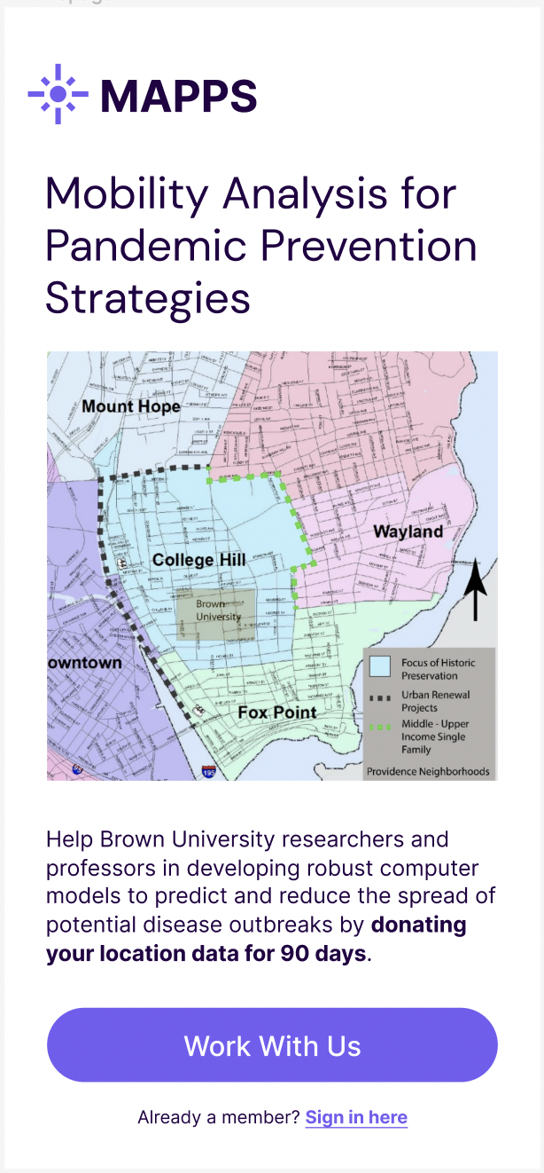
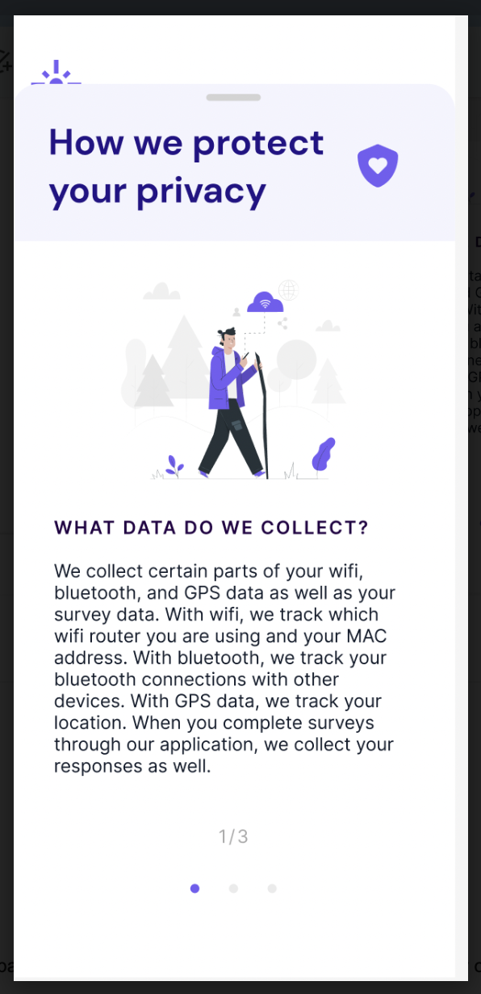
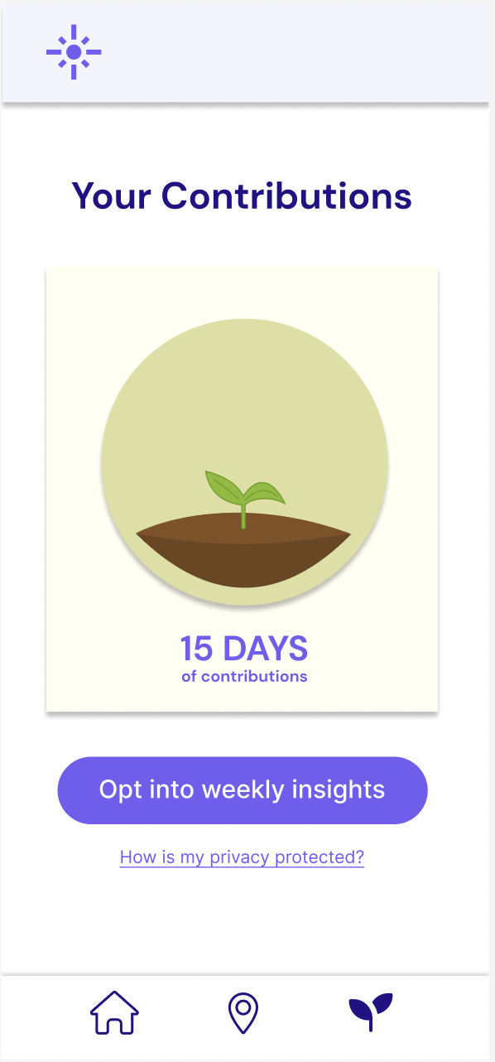
APP Development: Some early app prototypes

Slide 11
Focus groups with potential users
Attitudes about MAPPING@Brown
Undergraduates: Support for research, indifference to tracking, personal and community data insights, financial or material compensation, peer participation
Graduates: Support for research, personal and community data insights, financial or material compensation
Staff: Support for research, personal data insights, material compensation
Interaction with phone modules
Majority regularly deactivate Wi-Fi on campus (slow)
86% always have Bluetooth activated
Half of students and all staff allow location tracking ‘only while using app’
n = 28
Notes:
public health research team held 8 focus group discussions in November, 4 with Brown faculty and staff and 4 with undergraduate and graduate students. A total of 28 Brown community members participated, of which 3 were masters students, 18 were undergraduate students, and 7 were staff members.
When around campus, most students and staff turn wifi off at least occasionally because it’s slow in certain places.
Majority of students have BT on all the time. About half of staff members always have BT on. The other half only turn it on for a specific purpose (e.g. connecting to a car entertainment system). About half of students pretty uniformly preferred allowing location services ‘only while using app.’ The majority of staff preferred this option as well. All masters students and staff members cited the importance of the research as their main reason for participation.
The vast majority of respondents said personal data insights would be a big incentive to participate. The general consensus was that insights should be weekly. Ideas included where you spend the most time, what your typical routes are around campus, and how much time you spent outside. Almost everyone agreed that the design of insights should be done carefully so as not to affect participants’ behavior during the course of the study.

Slide 12
Focus groups with potential users
Concerns with proposed study design
Top issue – data access and ownership
Students’ primary concern was future use of data
Staff more likely to be concerned with re-identification
Transparency about potential battery life impact
App UI prototype feedback
Felt at ease with simple and intuitive design
Students liked seeing their data contribution grow - Customizable? Linked to incentives?
Interested in reminders to reactivate tracking modules
Most appreciated that registration focused on ethics, privacy, and consent; wanted options for consuming this info
n = 28
Notes:
Students’ primary concern was not the collection of the data per se but rather the utilization of the data going forward. Common questions were about who could see the data, whether it could be sold, how long it would be stored for, and whether it would be used for research beyond Brown. Similarly, the reassurance that employers would not be able to access the data was important to staff.
No one objected to the collection of demographic information such as age, gender, and race / ethnicity.
Reidentification is the discovery, or determination, of the identity of the individuals who are the subjects of a study through data linkage techniques. This often occurs when data is combined with external 'auxiliary information' to reveal information about an individual.
The re-identification issue gave the majority of students some pause, though most felt reassured that the risk was minimal though existent.
Re-identification was the primary concern for several staff members, while the rest were more worried about practical questions, such as battery life.
Being informed about the potential battery life impact of the app was important to students as well. Most raised the issue of being up front about this when laying out the benefits and drawbacks. Some said they would benefit from a detailed explanation on what steps we’re taking to conserve their battery while they use the app.
Students and staff commented on the simplicity and intuitive design of the app. One student noted, for instance, that they liked the fact that they could click through the questions without having to type anything.
In general, students liked that the app registration centered on ethical considerations. A few said they couldn’t be bothered to read the whole thing and suggested we cut down on wording. Several masters students and staff members recommended a video explanation of MAPPS, while a minority of undergraduates were enthusiastic about the idea. When probed, most undergrads said 30 seconds was the maximum length video they’d be likely to watch on data usage and ethics.
Students and staff were both generally interested in receiving notifications to turn their Bluetooth/location/Wi-Fi back on if they have turned it off. They recognized the importance of data completeness and said they would not mind if notifications were occasional (one suggestion was max once an hour).

Slide 13
Data
Device
MAPPING@Brown
Modeling and Prediction
Ethics, privacy, confidentiality

Slide 14
Data collection
Ethical concerns
Privacy protection
Simulation design
Data storage & collaboration
MAPPING@Brown Breakouts

Slide 15
Breakout 1
What data will we collect during MAPPING@Brown in order to map mobility and social mixing patterns within the Brown community? How and how often might these data be collected?
Desired outcomes:
A list of the specific data needs for the MAPPING@Brown exercise to capture mobility, mixing and other relevant data during Phase 1 (small, stripped-down pilot in the SPH), Phase 2 (roll-out across Brown), and Phase 3 (broader applications 5-10 years in the future).
Categorize measurements as either primary (highly important, priority data that is critical for analysis) or secondary (less important data that we may consider) during each phase.
Identify how and how often each type of data would be best measured during each phase.
Data collection

